Slide 1
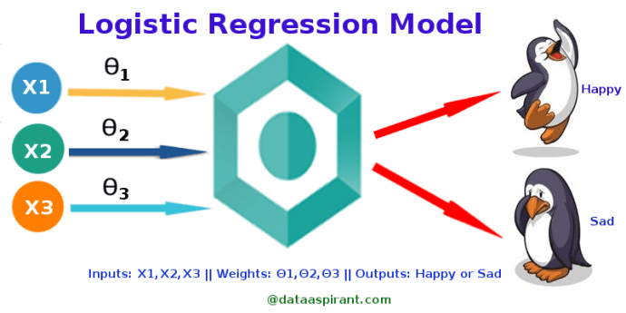
Logistic regression
What is logistic regression?
“Logistic regression measures the relationship between the categorical dependent variable and one or more independent variables by estimating probabilities using a logistic function” (Wikipedia)
The dependent variable is the target class variable we are going to predict (y)
dependent variables are the features or attributes we are going to use to predict the target class (x)

Slide 2
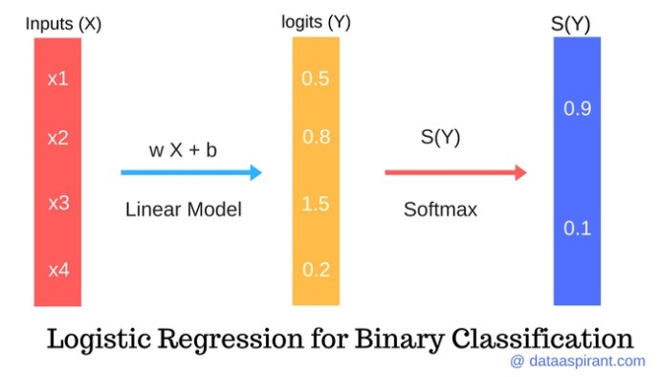
Thus, z=Wx+b, is just an activation value that encodes how far from and to which side of the decision hyperplane or boundary an input point x falls.

